Slide 1
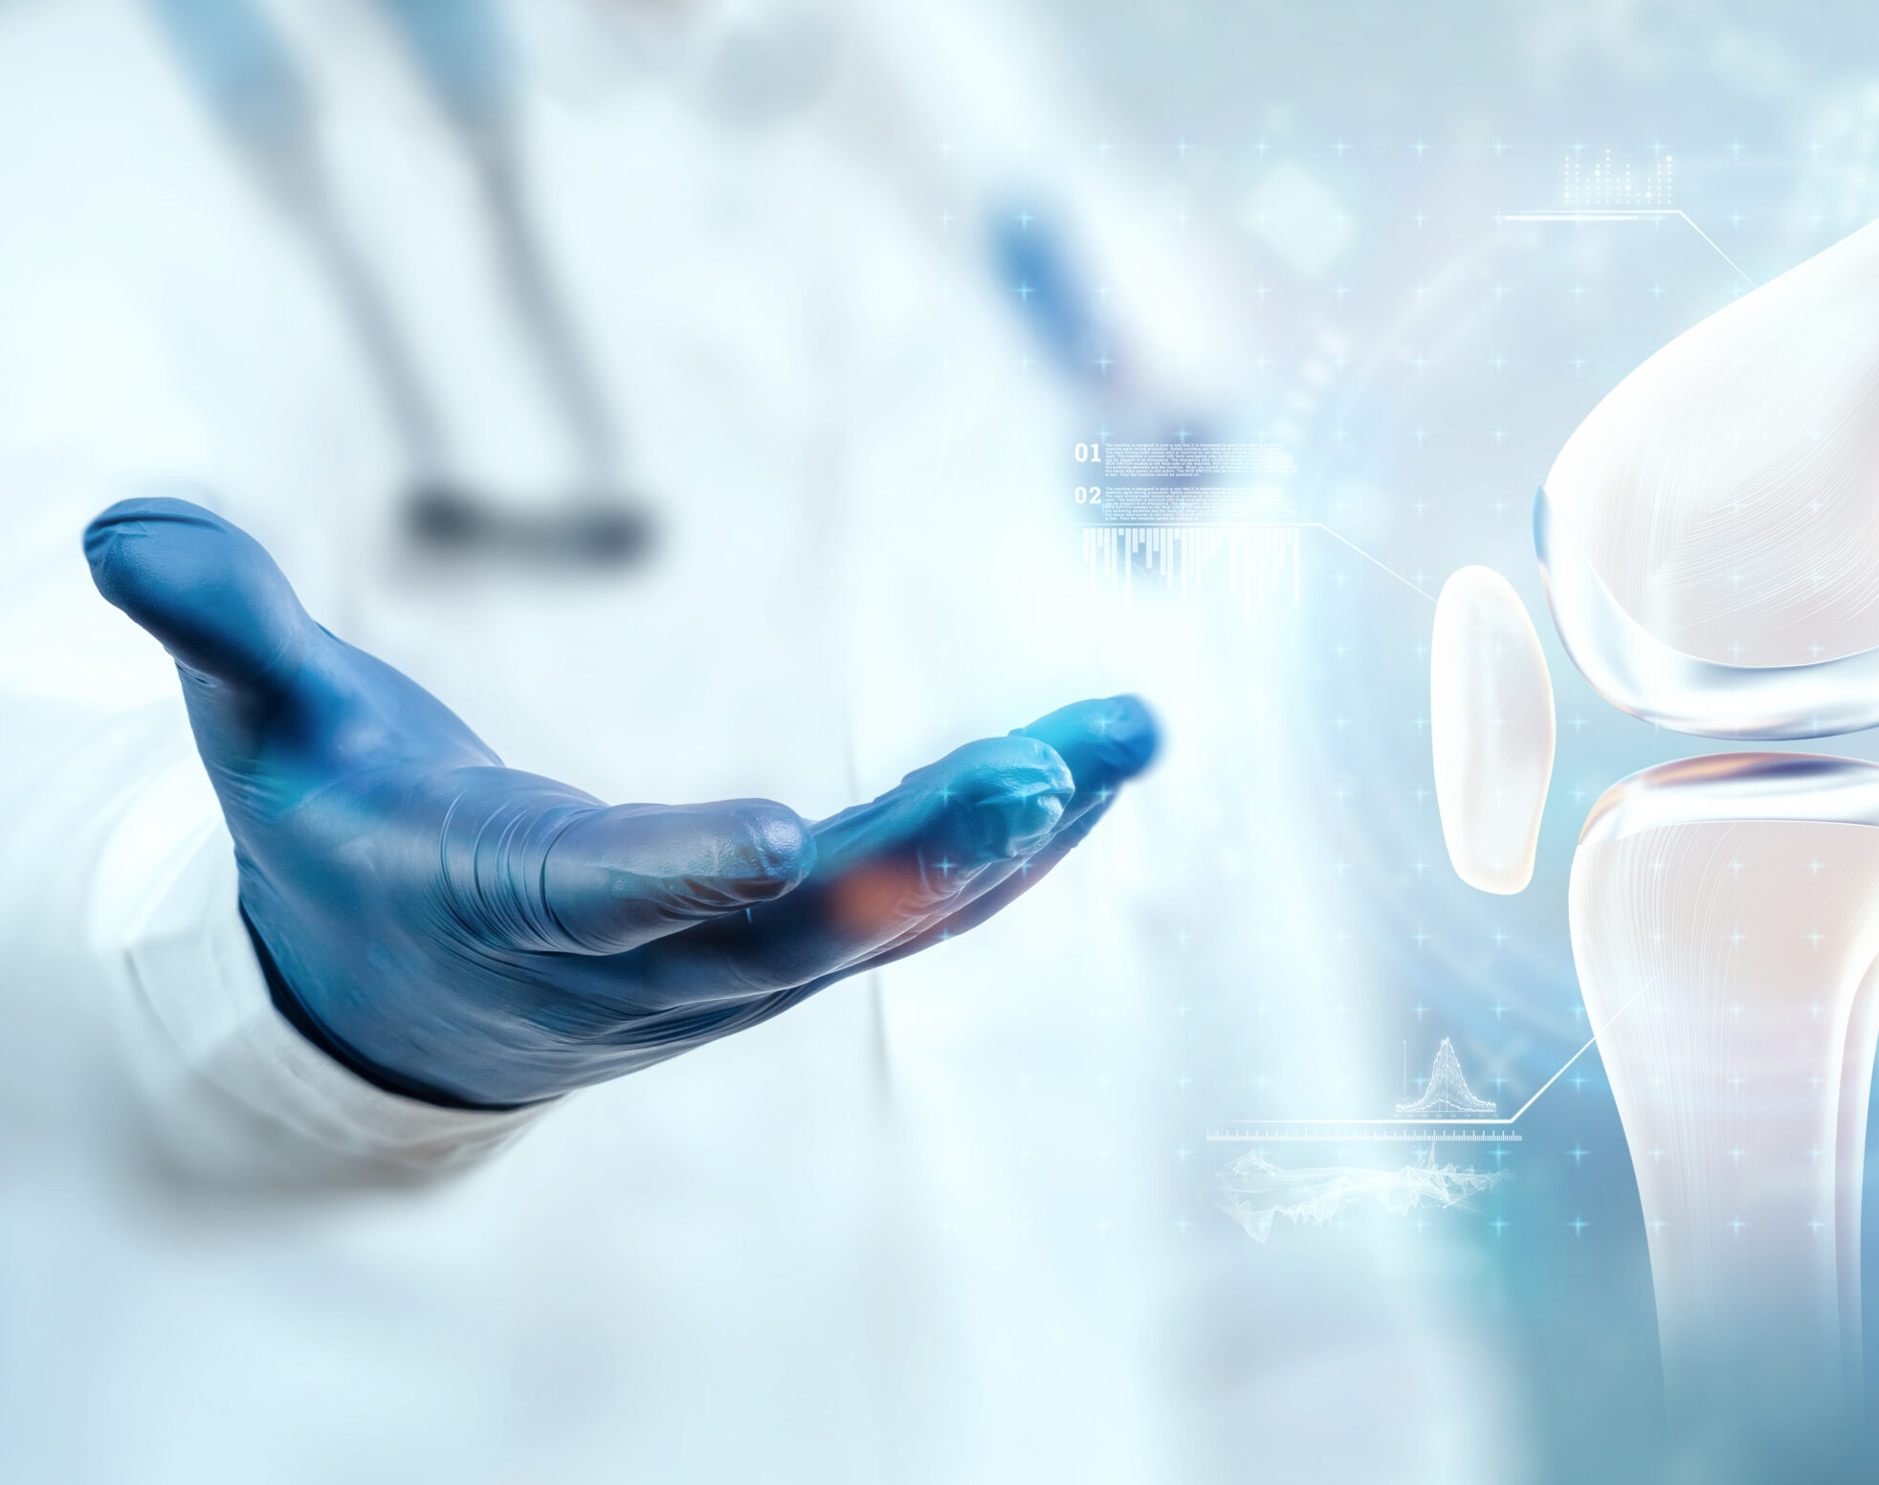
Knee Osteoarthritis Detection using CNN

Slide 2
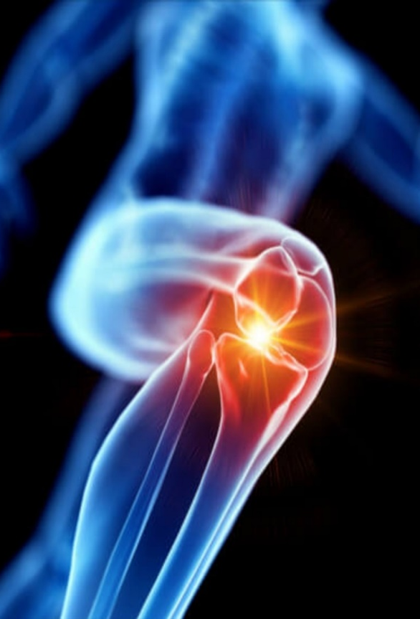
INTRODUCTION
Knee Osteoarthritis (KOA) is common in older individuals due to the wearing down of cartilage in knee joints. It affects approximately 13% of women and 10% of men over the age of 60 in the U.S. and impacts over 250,000 people worldwide.
Diagnosis typically employs the Kellgren- Lawrence (KL) grading system, which uses X-rays as a cost-effective and accessible method. Standardized by the World Health Organization (WHO) in 1961, the KL grading system categorizes KOA severity into five grades: 0 (healthy), 1 (doubtful), 2 (minimal), 3 (moderate), and 4 (severe).

Slide 3
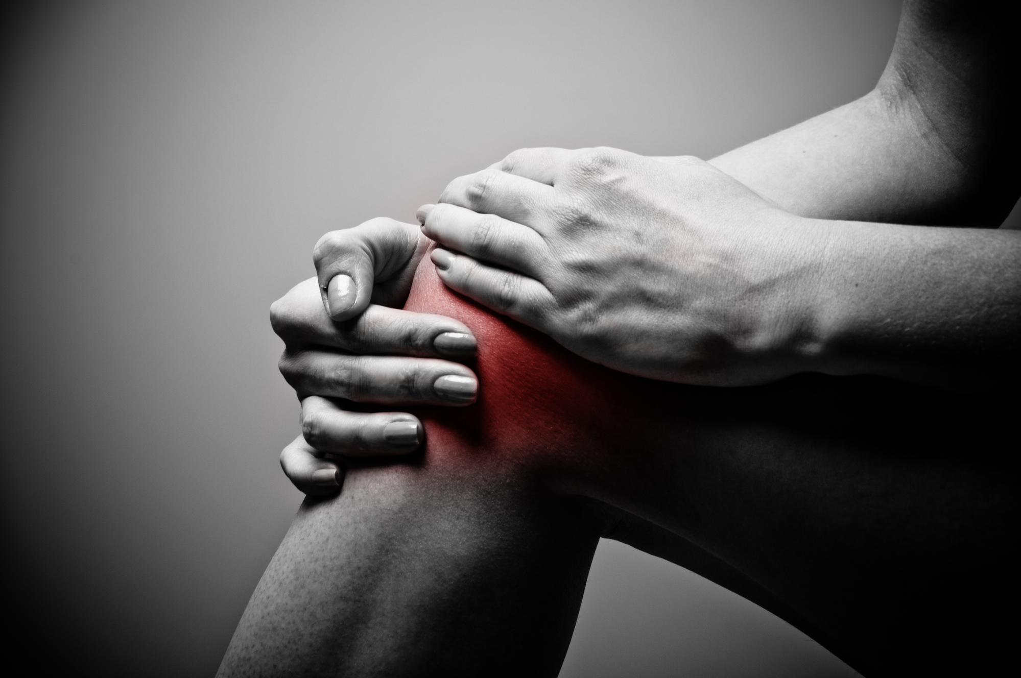
ABSTRACT
Osteoarthritis (OA) commonly affects the knee joint, characterized by the breakdown of articular cartilage, leading to pain, swelling, stiffness, and reduced motion.
While X-rays are commonly used, MRI is the best non-invasive technique for detecting cartilage, ligament, and tendon injuries. The proposed approach uses pixel-based segmentation to analyze cartilage sections on MRI.

Slide 4
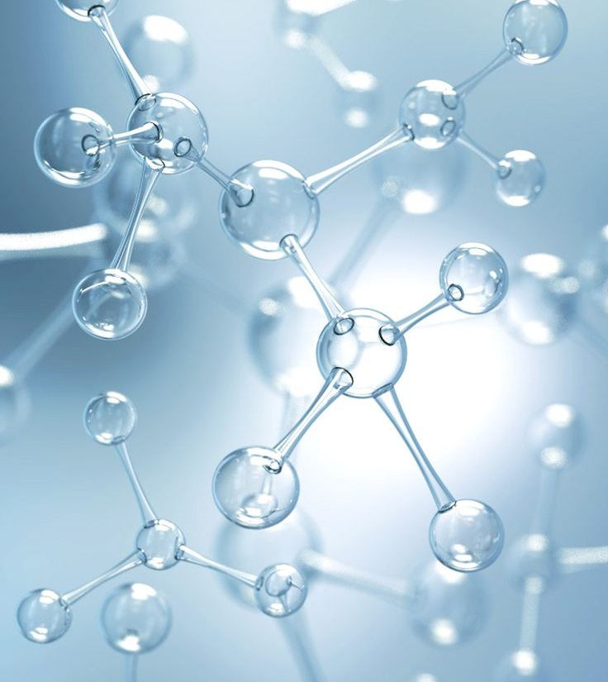
MOTIVATION
Early Diagnosis: Knee Osteoarthritis is a degenerative joint disease that develops slowly over time. Detecting it in its early stages can significantly improve patient outcomes and reduce the progression of the disease.
Automation and Efficiency: CNNs can process large volumes of medical images quickly and accurately, making them suitable for screening and diagnosis.
Improved Patient Care: Timely detection of Knee Osteoarthritis can lead to more effective treatment options, including lifestyle modifications, physical therapy, and medication.
Reducing Healthcare Costs: Knee Osteoarthritis is a costly condition for both individuals and healthcare systems.

Slide 5
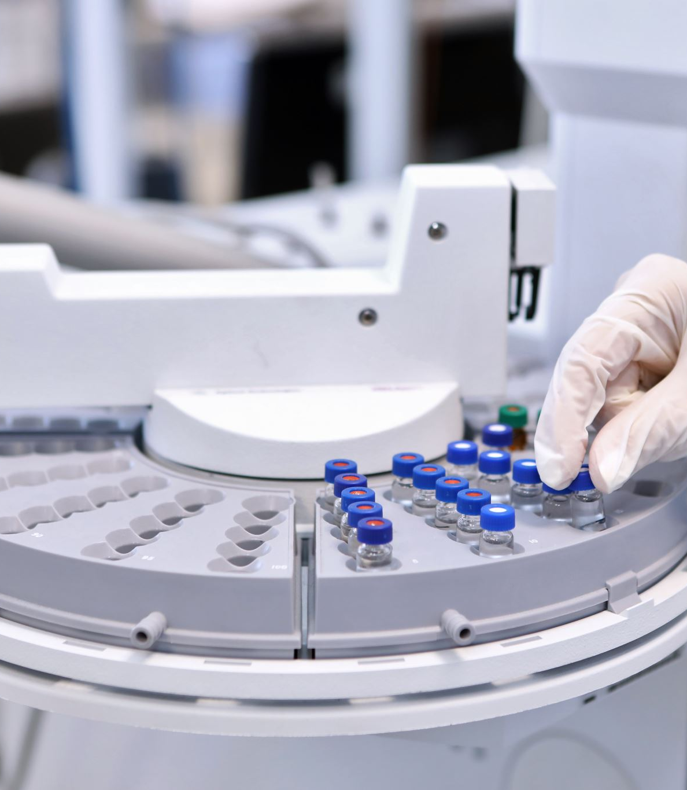
OBJECTIVES
Early Detection: Identify the presence of Knee Osteoarthritis in its early stages, allowing for prompt intervention and management.
Accuracy: Develop a highly accurate diagnostic tool that can distinguish between healthy knee joints and those affected by Osteoarthritis.
Efficiency: Create an efficient and automated system for analyzing medical images (such as X-rays or MRI scans), reducing the workload on healthcare professionals and speeding up the diagnosis process.
Precision: Detect specific structural changes or markers associated with Knee Osteoarthritis, such as cartilage degeneration, bone spurs, or joint space narrowing.
Scalability: Design a system that can handle a large volume of medical images, making it suitable for screening and diagnosis in various healthcare settings.
Patient-Centered Care: Improve patient care by enabling early intervention and tailored treatment plans, taking into account the individual’s specific condition and needs.

Slide 6
Literature Survey
Roll No | Paper Name | Author | Abstract
1 | Discriminative Regularized Auto-Encoder for Early Detection of Knee OsteoArthritis: Data from the Osteoarthritis Initiative | Yassine Nasser , Rachid Jennine | OsteoArthritis (OA) is the most common disorder of the musculoskeletalsystem and the major cause of reduced mobility among seniors. The visual evaluation of OA still suffers from subjectivity. Recently, ComputerAided Diagnosis (CAD) systems based on learning methods showed potential for improving knee OA diagnostic accuracy.
2 | Kinect-Based Knee Osteoarthritis Gait Analysis System | Ivan Yong-Sing, Lau, Tiing-Tiing, Chua | Measurement of the gait parameter typically requires a combination of force plate and motion tracking system, which restricts the calculated value to the laboratory environment. The possibility of a portable tracking system has been investigated in some recent studies, such as Microsoft Kinect sensors. The present research collaborated with Sibu Hospital and KPJ Sibu Specialist Hospital to collect the data from subjects
3 | Discriminative Regularized Auto-Encoder for Early Detection of Knee Osteoarthritis: Data from the Osteoarthritis Initiative | Yassine Nasser , Rachid Jennane | Osteo Arthritis (OA) is the most common disorder of the muscul oskeletal system and the major cause of reduced mobility among seniors. The visual evaluation of OA still suffers from subjectivity. Recently, Computer Aided Diagnosis (CAD) systems based on learning methods showed potential for improving knee OA diagnostic accuracy.
4 | Usefulness of Muscle Synergy Analysis in Individuals with Knee Osteoarthritis during Gait | K. Kubota, H. Hanawa, M. Sonoo, S. Kita, K. Hirata | To clarify whether there are any muscle synergy changes in individuals with knee osteoarthritis, and to determine whether muscle synergy analysis could be applied to other musculoskeletal diseases.

Slide 7
Problem Statement
Knee Osteoarthritis (KOA) is a prevalent and debilitating musculo skeletal condition that affects a substantial portion of the population worldwide.
Early detection of KOA is critical for effective intervention and management, but it often relies on subjective assessments by healthcare professionals, leading to diagnostic variability and delayed treatment.
To address this issue, the problem is to develop an automated and highly accurate CNN-based system for detecting Knee Osteoarthritis from medical imaging data, such as X-rays or MRI scans.

Slide 8
START
Upload Image Dataset
Dataset Preprocessing
Feature Extraction
Algorithm
Classification by Using CNN and SVM
Detect the Knee Osteoarthritis
Predict the doctor list and precautions
END

Slide 9
Convolutional Neural Network
This diagram shows how a computer can look at an X-ray image of a knee and decide how severe a knee condition is
1. Input (Knee X-ray Image):
- The process starts with an image of a knee X-ray, sized 112 by 112 pixels.
2. Convolution Layers (Blue blocks):
- These layers look at small parts of the image (3x3 pixels) to find important features. They use a method called ReLU to help the computer learn better.
- There are multiple convolution layers, each one with 32 filters, which means they look for 32 different features in the image.
3. Pooling Layers (Orange and Green blocks):
- These layers reduce the size of the image data, keeping the most important information. The orange blocks use Max pooling, which keeps the largest numbers from small sections of the image. The green blocks use Average pooling, which averages the numbers from small sections.
- The pooling layers help make the processing faster and reduce the amount of data the computer needs to handle.

Slide 10
Convolutional Neural Network
4. Dropout Layers:
- These layers help prevent the computer from learning the training data too well, which is called overfitting. They randomly ignore some information during the learning process. The percentages (0.25, 0.5, and 0.75) show how much information is ignored in each dropout layer.
5. Flatten Layer:
- This layer takes all the data from the previous layers and turns it into a long list (25,088 values) so it can be used in the next step.
6. Fully Connected (FC) Layer:
- This layer looks at all the features from the flattened layer and makes connections to understand the image better. It also uses dropout to avoid overfitting.
7. Output Layer:
- The final step is where the computer decides the severity of the knee condition. It uses something called the Softmax Activation Function to choose one of five categories: Normal, Doubtful, Mild, Moderate, or Severe.
In summary, the diagram shows a step-by-step process that a computer uses to analyze a knee X-ray and determine the severity of any condition present, using a series of image processing and decision-making steps.

Slide 11
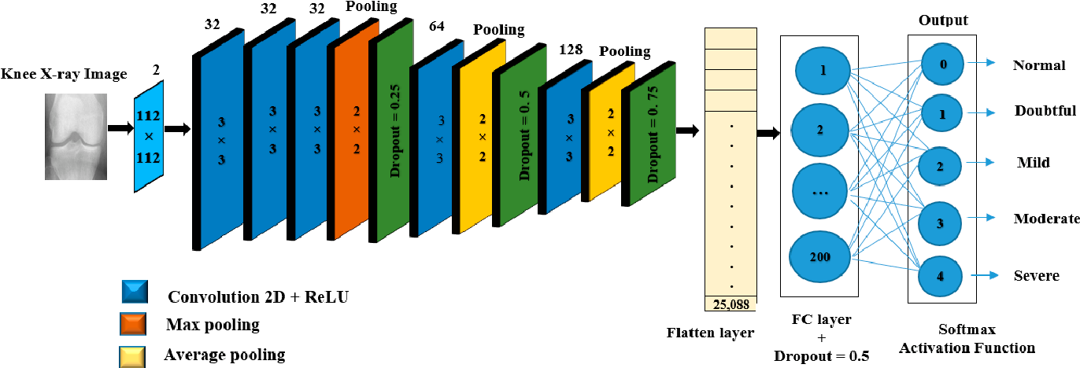

Slide 12
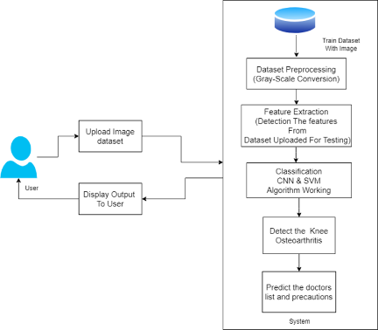
Architecture

Slide 13

Stages of implementation
Stage I: Data Collection and Preprocessing : Collect a diverse dataset of medical images, including X-rays and MRI scans, representing various stages of knee osteoarthritis.
Stage II: Model Architecture Design : Design a CNN architecture suitable for image classification tasks, considering factors such as depth, kernel size, and pooling layers.
Stage III :Model Training : Divide the dataset into training, validation, and test sets.
Stage IV: Model Evaluation : Test Set Evaluation: Assess the performance of the trained model on the test set to ensure its generalization to unseen data.
Stage V: Integration with Clinical Workflow : Develop a user-friendly interface for healthcare professionals to interact with the diagnostic tool.
Stage VI: Deployment : Optimize the model for deployment on different platforms, considering factors such as model size and computational requirements.
Stage VII: Continuous Improvement: Establish a feedback loop for continuous improvement by collecting user feedback and updating the model periodically with new data to enhance its performance.
Stage VIII: Ethical Considerations : Implement robust privacy and security measures to protect patient Address and mitigate biases in the model predictions, ensuring fair and equitable healthcare outcomes.

Slide 14

Future scope
Collaboration with Industry and Research Partners : Collaborative Research: Engaging in collaborative research with industry partners, research institutions, and healthcare organizations to advance the technology and validate its effectiveness in real-world clinical settings
Population Health Analytics: Contributing to population health studies by aggregating and analyzing data from various diagnostic tools to gain insights into the prevalence, distribution, and risk factors of knee osteoarthritis on a larger scale.
Expanded Musculoskeletal Applications Extension to Other Joint Disorders: Extending the technology to diagnose and monitor other musculoskeletal disorders beyond knee osteoarthritis, broadening its impact on orthopedic care.
Enhanced Interpretability : Explain ability Techniques: Further development of interpretability and explain ability techniques to provide healthcare professionals with clearer insights into how the model arrives at specific diagnostic decisions, promoting trust and transparency.

Slide 15
Challenges
Image Quality: Ensuring MRI images are clear and detailed.
Cartilage Segmentation: Accurately separating cartilage in MRI images.
Algorithm Precision: Developing precise image processing techniques.
Computational Power: Handling large MRI data efficiently.
Validation: Ensuring accuracy and reliability of results.
Software Limits: Overcoming potential issues in MATLAB R2013a.
Variability: Dealing with differences between patients.
Clinical Integration: Adapting the method for regular medical use.

Slide 16
Applications
Medical Diagnosis
Pain Management
Physical Therapy
Research and Development
Medical Education
Health Technology Development
Healthcare Policy
Mobility Aids and Orthotics
Patient Education

Slide 17
Conclusion
This research work addressed the identification and classification of knee osteoarthritis(KOA), which is one of the most challenging medical conditions in old-aged people. The efforts were directed toward proposing, implementing, and testing an automated , fast, and accurate methodology that can help reduce the manual efforts of the physician and decrease the amount of false diagnosis cases. For this purpose, we used the prediction capabilities of deep neural network

Slide 18

REFERENCES
1. Hunter, H.; Ryan, M.S. Knee Osteoarthritis-Stat pearls-NCBI Bookshelf. (4 August 2019). Available online: https://www.ncbi.nlm.nih.gov/books/NBK507884/ (accessed on 2 February 2023).
2.Schiphof, D.; Boers, M.; Bierma-Zeinstra, S.M. Differences in descriptions of Kellgren and Lawrence grades of knee osteoarthritis . Ann. Rheum. Dis. 2008, 67, 1034–1036. [CrossRef] [PubMed]
3. Kellgren, J.H.; Lawrence, J.S. Radiological Assessment of Osteo-Arthrosis. Ann. Rheum. Dis. 1957, 16, 494–502. [CrossRef]
[PubMed]
4. Chen, P.; Gao, L.; Shi, X.; Allen, K.; Yang, L. Fully automatic knee osteoarthritis severity grading using deep neural networks with a novel ordinal loss . Com put. Med. Imaging Graph. 2019, 75, 84–92. [CrossRef] [PubMed]
5. Roy, S.; Meena, T.; Lim, S.-J. Demystifying supervised learning in healthcare 4.0: A new reality of transforming diagnostic medicine. Diagnostics 2022, 12, 2549. [CrossRef] [PubMed]

Slide 19


